Slide 1
BENGAL COLLEGE OF ENGINEERING AND TECHNOLOGY, DURGAPUR QUALITY ANALYSIS AND CLASSIFICATION OF RICE GRAINS
TEAM MEMBERS:- SHIPRA KUMARI (12500119183)
SONI KASHYAP (12500119188)

Slide 2
INTRODUCTION
Rice is favourable and high consumed cereal grain in Asian countries. It can be easily found all over the world. Many values added products are produced by using rice for human beings. In the rice market, key determinant of milled rice is quality. The quality measurement becomes more important with the import and export trade. Rice samples contain different dispensable objects like paddy, chaff, damaged grains, weed seeds, stones etc. Rice quality is varying according to these impurity content.
The main purpose of the proposed method is, to offer an alternative way for quality control and analysis which reduce the required effort, cost and time. Image processing is significant and advanced technological area where important developments have been made.
In agricultural and farming production quality control and analysis of manufactured goods is vital. Quality of grain is analyzed visually by veteran person and technician. But the effect of such measurement is changing in results and prolonged. The excellence and quality also influenced by the mood and atmosphere of technician; so to overcome the shortcoming occurred due to conventional methods advanced technique i.e. Image processing technique is projected, to Maintaining the Integrity of the Specifications.
Image processing manipulates image for performing some operations on targeted image to get an improved and desirable image. And extort some valuable information from input image. Nowadays, image processing is hastily growing technologies. All types of data have to go through three general phases while using DIP technique which are pre-processing, enhancement, and display, information extraction.

Slide 3
OBJECTIVE
Use of image processing algorithms to analyse grains quality by its size. To analysis and classify the quality of rice grains.

Slide 4
MOTIVATION
In this study, the image processing algorithms are developed to segment and identify rice grains. use of image processing algorithm is an efficient method to analyse grains quality by its size. The paper presents a solution of grading and evaluation of rice grains on the basis of grain size and shape using image processing techniques. Specifically, edge detection algorithm is used to find out the region of boundaries of each grain. In this technique we find the endpoints of each grain and after using caliper we can measure the length and breadth of rice. This method requires minimum time and it is low in cost.
The conventional methods used for grain shape and size measurement are grain shape tester, dial micrometer and graphical method, but these methods are very lengthy. In above equipment we can measure breadth and length of one grain at a time. The result of this methods is also lengthy and costly and higher possibility of human errors, so it requires high accuracy to assure customers need as well as to conquer restrictions of manual.
Many studies that consider the morphological features of grains such as its area, shape etc. have already been performed. However, the shapes and sizes of the different varieties are too varied to generalize a common formula for the classification of all varieties of rice. In this paper, Fourier features are also extracted from grain images in addition to the spatial features to arrive at an improved accuracy for classification.

Slide 5
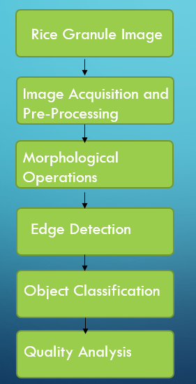
SYSTEM ARCHITECTURE

Slide 6
PROJECT DESCRIPTION AND GOALS
TECHICAL SPECIFICATIONS:
Python
Image processing
Python Flask for website

Slide 7
Design approach
The image processing technique is used for counting the number of rice seeds and classifies them on the basis of length, breadth and length - breadth ratio.
Length is the average length of rice grain while breadth is the average breadth of rice grain and length-breadth ratio is calculated as: L/B = [(Average length of rice grain)/(average breadth of rice)]*10.
In first pre-processing step image registration takes place and noise is removed from the image by using filter.
Shrinkage algorithm used for segmenting the touching kernels which is second step.
In third step we perform edge detection to find out the region of boundaries.
In fourth step rice seed measurement is done and in the same step length, breadth and length-breadth is also measured.
In the fifth step of the algorithm rice is classified according to its size and shape.

Slide 8
Methods used
Image pre-processing –
Filter is applied to remove noise which occurs during the acquisition of image. Filter also sharpens the image. Threshold algorithm is used to segment the rice grains from the black background.
Shrinkage morphological operation-
Erosion is applied to separate the touching features of rice grains without losing the integrity of single feature. Dilation process follows erosion process. The goal of dilation is to grow the eroded features to their original shape without re-joining the separated features.
Edge detection
Edge detection helps to find out the region of boundaries of rice grains. We use canny algorithm to detect the edges.

Slide 9
Object measurement
Measurement indicates the count of rice grains. After getting the count of rice grains, edge detection algorithms applied on the image and outcome of the applied algorithm is we get endpoint values of each grain. We use calliper to join the endpoints and measure the value of length and breadth of each grain. After getting the value of length and breadth we can calculate length-breadth ratio.
Object classification
Classification requires all standard, measured and calculated results. The standard database for rice size and shape measurement is referred from laboratory manual on rice grain quality, Directorate of Rice Research, Rajendra nagar, Hyderabad. The classification of rice grains as per the standard database is shown in following tables.

Slide 10
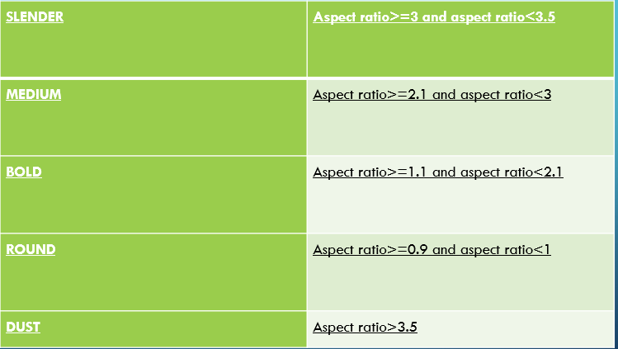
Table below indicates classification of rice grains on the basis of length and length- breadth ratio:

Slide 11
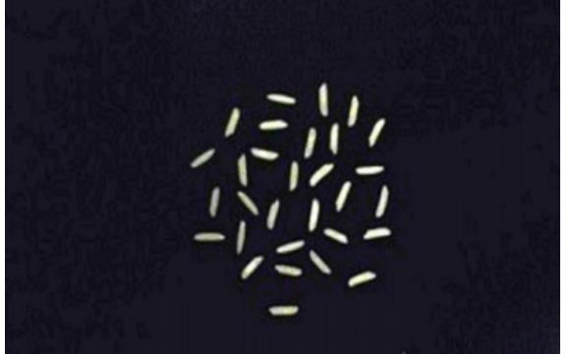
Project demonstration
INPUT IMAGE

Slide 12
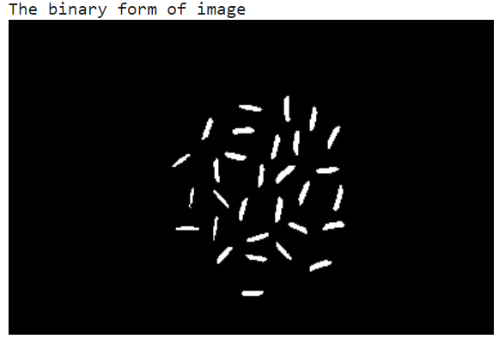
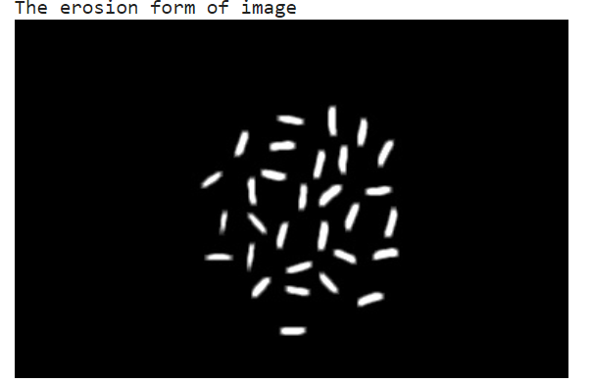
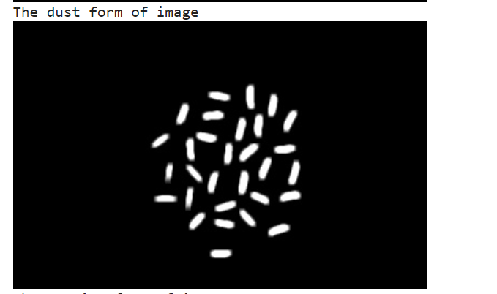
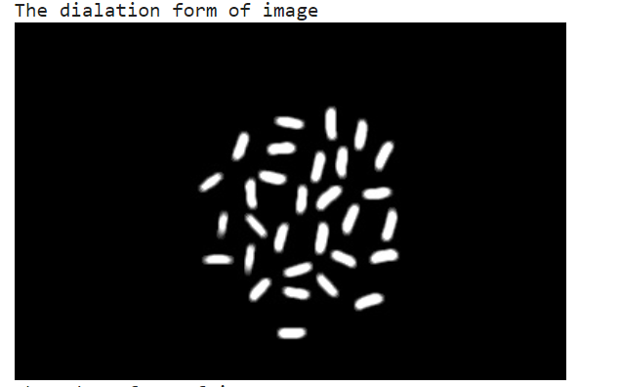
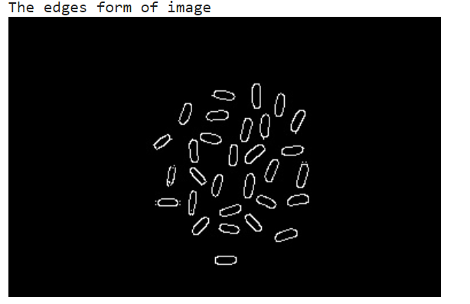

Slide 13
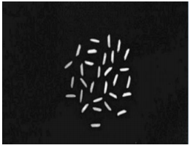
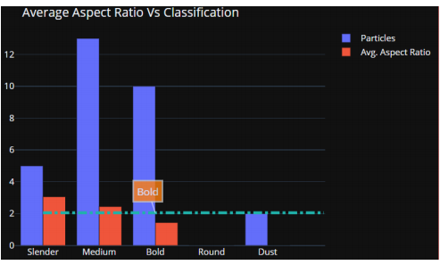
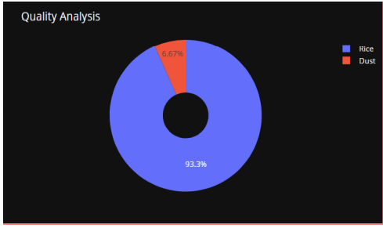
comparision
S.no | INPUT | OUTPUT
1

Slide 14
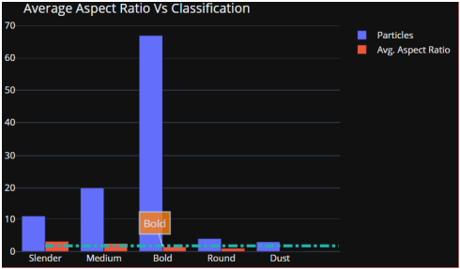
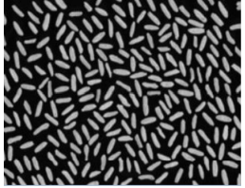
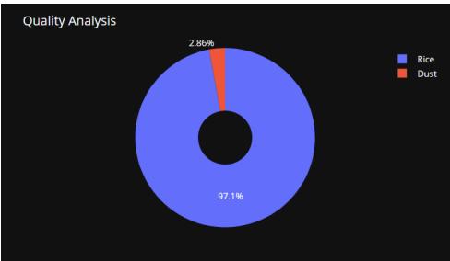
S.no | INPUT | OUTPUT
2

Slide 15
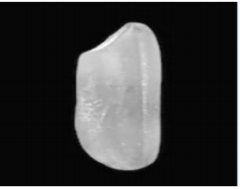
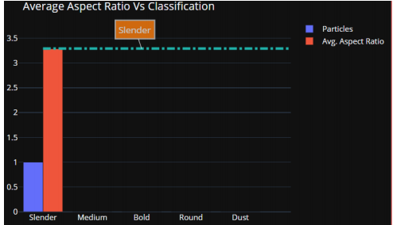
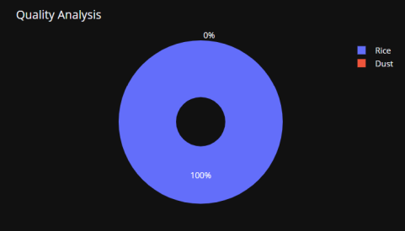
S.no | INPUT | OUTPUT
3

Slide 16
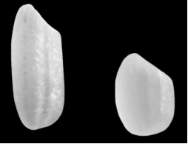
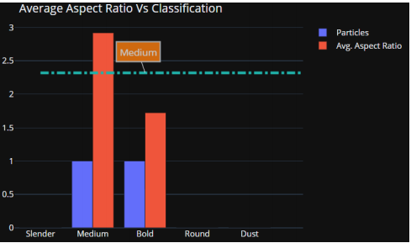
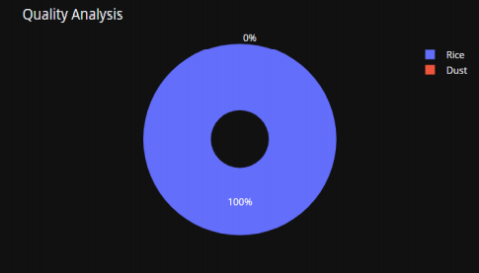
S.no | INPUT | OUTPUT
4

Slide 17
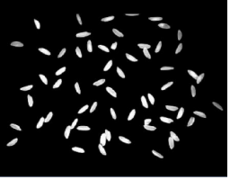
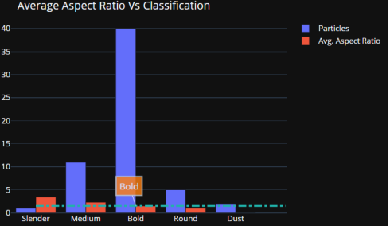
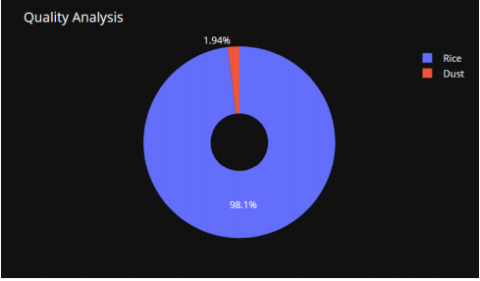
S.no | INPUT | OUTPUT
5

Slide 18
Grouped Bar chart – Used for Classification purpose
• Blue Bar indicates the Number of Rice grains.
• Red Bar indicates Average Aspect Ratio.
Pie chart – Used for Quality Analysis purpose
• Blue Section indicates percentage of Rice grains in the given sample.
• Red Section indicates percentage of Dust in the given sample.

Slide 19
Results and discussion
In this project, we are classifying the rice grain sample taken into various categories and also analysing its quality based on its aspect ratio, so it is not possible to compare with other works. Existing works only detect the rice grains, or calculate number of rice grains in the given sample but our work helps to analyse the quality of rice sample and classify them into particular category.
Quality of grains in the samples should be nearly 100% accurate and it should be suitable to grade large quality of grains efficiently, which otherwise will consume lot of time in manual analysis, this feature will be able to save lot of time & human effort
The main benefit of proposed method is it requires minimum time; cost is less and gives better results compared with manual results or traditional methods

Slide 20
THANK YOU…..

